Slide 1
SWEN90016 Software Processes & Project Management
Configuration
and
Version Control
2019 – Semester 2
Tutorial 9
Copyright University of Melbourne 2017

Slide 2

Today’s aim
Become familiar with
GIT
Github
https://github.com/microsoft

Slide 3
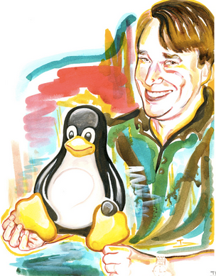
So what is Git?
Version Control System
Made by Linus Torvalds!
who, what, where, when of code
famous guru - transformed technology twice
Created kernel for Linux OSs , Android and Chrome OS
Created Git, the source code management system
meet Tux, slightly overweight penguin

Slide 4
So what is Git?
From Lecture 10, slide 14
WHAT: identify artefacts under versioning control
WHERE: items stored in REPO: version control repository
WHO: tags items with your name (collection remains consistent)
WHEN: tags item with date (versions exist)
WHY: quality code sharing, back up, roll-back, parallel branching
The “why” is recorded by your comment on the commit!

Slide 5
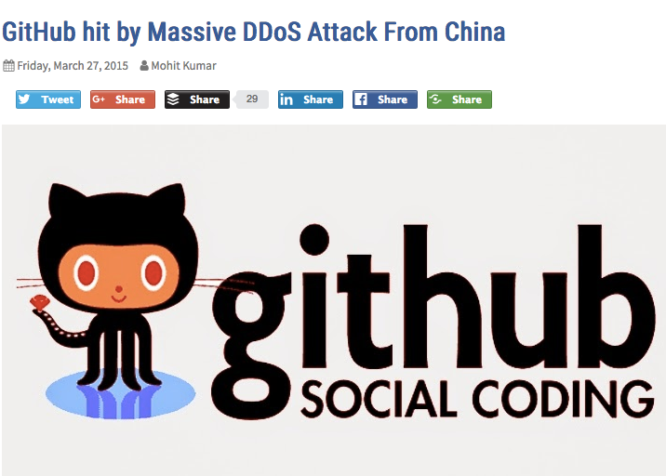
Git Advantages
Distributed (everyone has their own code repository local to them!)
Open Source (everyone likes open source code 😀)
Bomb proof

Slide 6
General Git Workflow
git init
git add filename
git commit -m “message”
git push
Initialize local repository called master
Track changes made to the contents of this file
Save this file in local repository
Save this collection
- to remote repository called origin
- from local repository called master

Slide 7
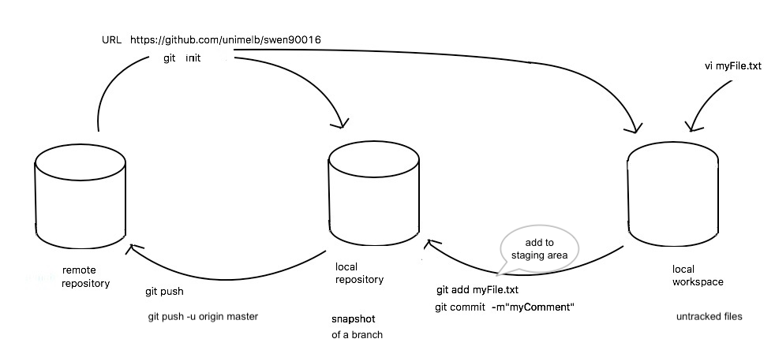
git Round Trip
my file
init
origin
master
push
add, commit

Slide 8
github
No Coding Necessary
To complete this tutorial, you need a https://github.com/microsoft and Internet access. You don’t need to know how to code, use the command line, or install Git (the version control software GitHub is built on).
Tip: Open this guide in a separate browser window (or tab) so you can see it while you complete the steps in the tutorial.

Slide 9
github
Step 1. Create a Repository
A repository is usually used to organise a single project. Repositories can contain folders and files, images, videos, spreadsheets, and data sets – anything your project needs.
GitHub makes it easy to add one at the same time you create your new repository. It also offers other common options such as a license file.
Your hello-world repository can be a place where you store ideas, resources, or even share and discuss things with others.

Slide 10
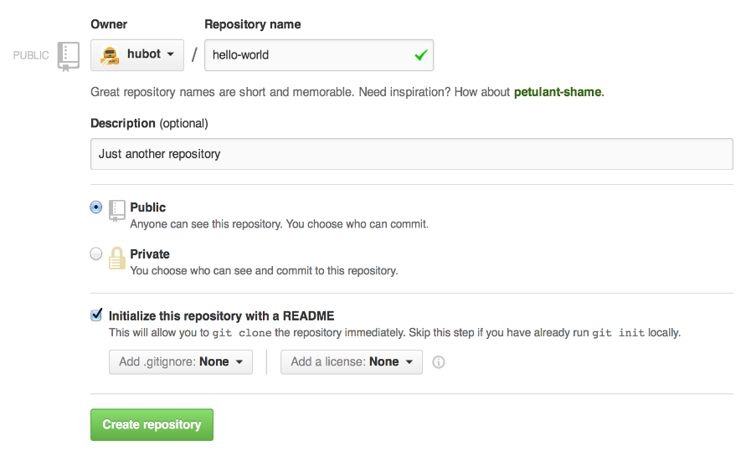
github
To Create a New Repository
In the upper right corner, next to your avatar or identicon, click + and then select New repository.
Name your repository hello-world.
Write a short description.
Select Initialize this repository with a README.

Slide 11
github- branching
Step 2. Create a Branch
Branching is the way to work on different versions of a repository at one time.
By default, your repository has one branch named master which is considered to be the definitive branch. We use branches to experiment and make edits before committing them to master.
When you create a branch off the master branch, you’re making a copy, or snapshot, of master as it was at that point in time. If someone else made changes to the master branch while you were working on your branch, you could pull in those updates.

Slide 12
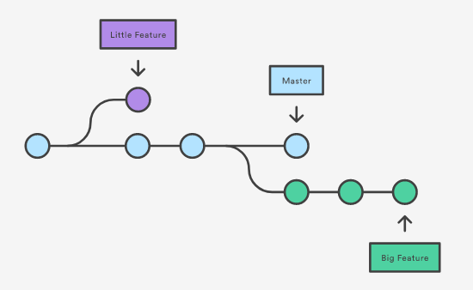
git concept: branching
Notes:
Parallel development

Slide 13
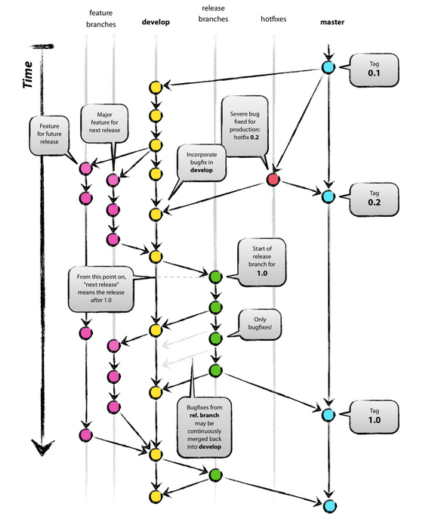
Notes:
http://nvie.com/posts/a-successful-git-branching-model/
Discuss the following git development configuration. Identify where the hotfix get merged into the master branch and the develop branch.

Slide 14
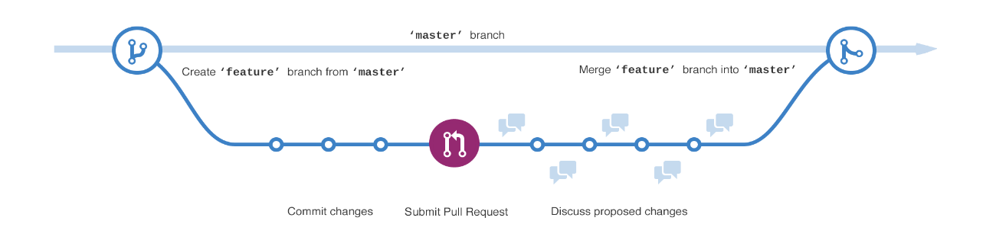
github
Step 2. Create a Branch
This diagram shows:
The master branch
A new branch called feature (because we’re doing ‘feature work’ on this branch)
The journey that feature takes before it’s merged into master
Have you ever saved different versions of a file? Something like:
story.txt
story-joe-edit.txt
story-joe-edit-reviewed.txt

Slide 15
github
To Create a New Branch
Go to your new repository hello-world.
Click the drop down at the top of the file list that says branch: master.
Type a branch name, readme-edits, into the new branch text box.
Select the blue Create branch box or hit “Enter” on your keyboard.
Now you have two branches, master and readme-edits. They look exactly the same, but not for long! Next, we’ll add our changes to the new branch. story-joe-edit-reviewed.txt

Slide 16
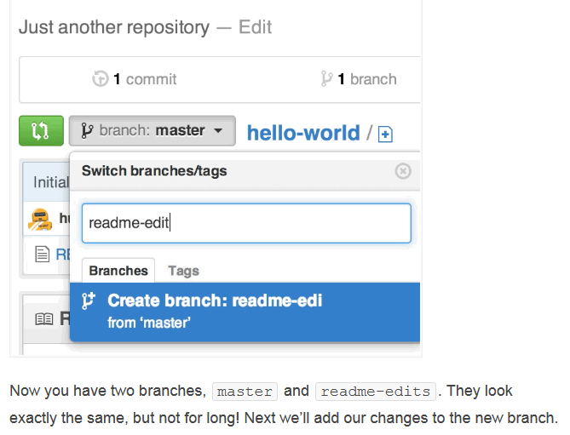
github

Slide 17
github
Step 3. Make and Commit Changes
Bravo! Now, you’re on the code view for your readme-edits branch, which is a copy of master. Let’s make some edits.
On GitHub, saved changes are called commits. Each commit has an associated commit message, which is a description explaining why a particular change was made. Commit messages capture the history of your changes, so other contributors can understand what you’ve done and why.

Slide 18
github
Step 3. Make and Commit Changes
Click the README.md file.
Click the pencil icon in the upper right corner of the file view to edit.
In the editor, write a bit about yourself.
Write a commit message that describes your changes.
Click Commit changes button.
These changes will be made to just the README file
on your readme-edits branch,
so now this branch contains content that’s different from master.

Slide 19
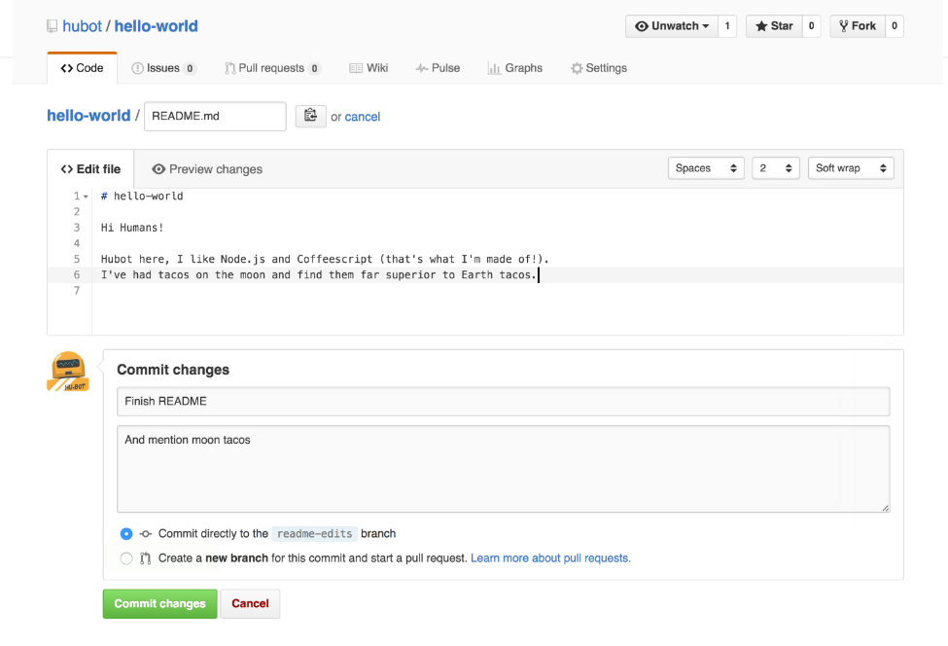
github

Slide 20
github
Step 4. Open a Pull Request
Pull Requests are the heart of collaboration on GitHub. When you open a pull request, you’re proposing your changes and requesting that someone review and pull in your contribution and merge them into their branch. Pull requests show diffs, or differences, of the content from both branches. The changes, additions, and subtractions are shown in green and red.
As soon as you make a commit, you can open a pull request and start a discussion, even before the code is finished.
By using GitHub’s @mention system in your pull request message, you can ask for feedback from specific people or teams, whether they’re down the hall or 10 time zones away.
You can even open pull requests in your own repository and merge them yourself. It’s a great way to learn the GitHub flow before working on larger projects.

Slide 21
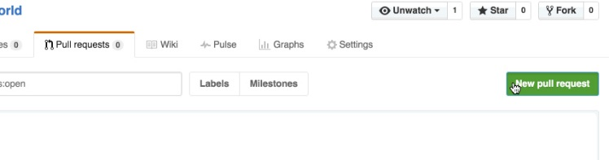
github
Open a Pull Request for Changes to the README
Click the Pull Request tab, then from the Pull Request page, click the green New pull request button.

Slide 22
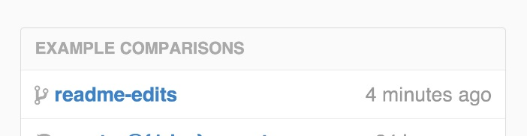
github
Open a Pull Request for Changes to the README
In the Example Comparisons box, select the branch you made, readme-edits, to compare with master (the original).

Slide 23
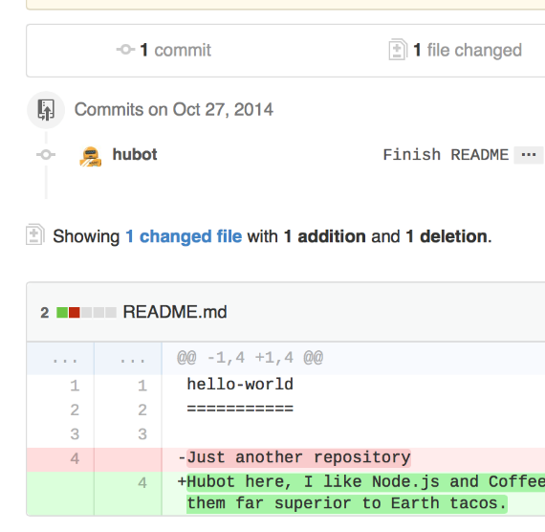
github
Open a Pull Request for Changes to the README
Look over your changes in the diffs on the Compare page, make sure they’re what you want to submit.

Slide 24
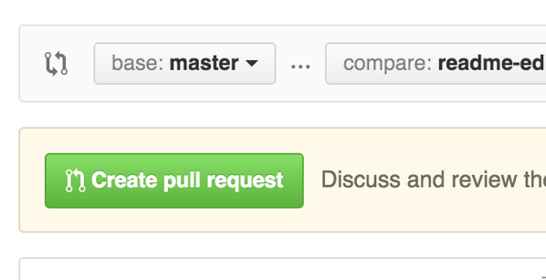
github
Open a Pull Request for Changes to the README
When you’re satisfied that these are the changes you want to submit, click the big green Create Pull Request button.

Slide 25
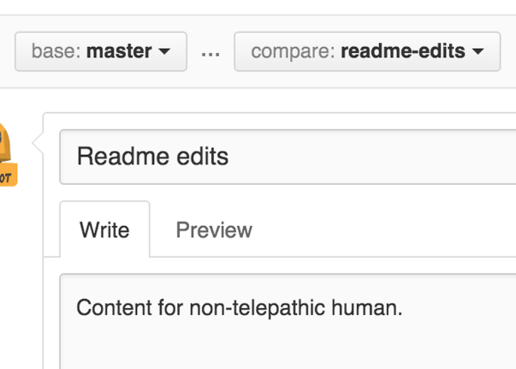
github
Open a Pull Request for Changes to the README
Give your pull request a title and write a brief description of your changes
When you’re done with your message, click Create pull request!

Slide 26
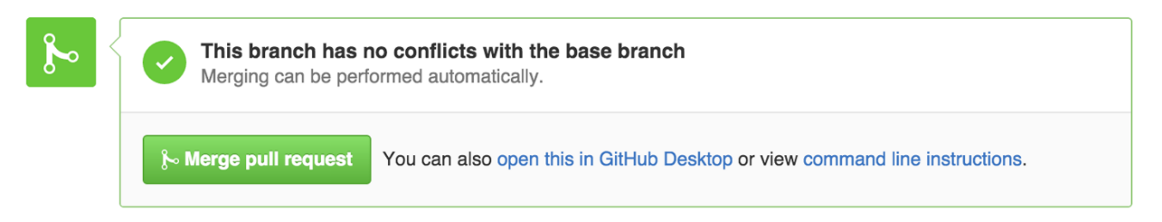
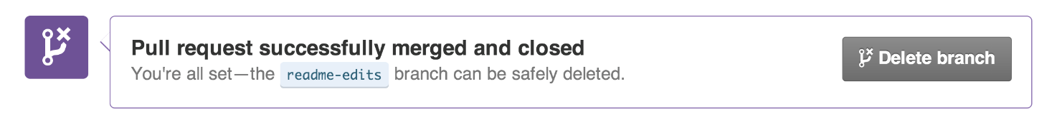
github
Step 5. Merge Your Pull Request
In this final step, it’s time to bring your changes together – merging your readme-edits branch into the master branch.
Click the green Merge pull request button to merge the changes into master.
Click Confirm merge.
Go ahead and delete the branch, since its changes have been incorporated, with the Delete branch button in the purple box.

Slide 27
github
Open a Pull Request for Changes to the README
When you’re satisfied that these are the changes you want to submit, click the big green Create Pull Request button.

Slide 28
Miscellaneous
Well done! Now you know how to create a repository.
What next?
1. SDLC for an existing project
2. Risk Management

Slide 29
Coffee co website
CoffeeLovers is an existing website which sells café type coffee to the public. The owners want to expand to sell tea using the same model.
Choose an SDLC
How is it different to an new software development project?

Slide 30
Coffee co website- Risk
CoffeeLovers is an existing website which sells café type coffee to the public. The owners want to expand to sell tea using the same model.
Identify some key risks
Discuss ways to manage those risks

Slide 31
Risk- bad examples
Actual Poor Examples: (all taken from page 1 of Google in Dec 2015)
“Scope is ill-defined“.
“The project may be late”.
“Project estimates are very optimistic”.
“Poor data quality”.

Slide 32
Risk- good examples
There is a risk that:
“the export licence may not be granted.”
“ground conditions may not be suitable for ….”
“key (specific) system interfaces may not be compatible.”
“there may not be the physical space for a required equipment.”
“data rates for required image quality may exceed capacity.”
“the regulator may introduce new requirements relating to…”
“severe weather may impact progress”
“(the requirement for) full spatial coverage may not be physically possible”

Slide 33
Done!
References:
https://www.pmis-consulting.com/example-project-risks-good-and-bad-practice/
https://www.atlassian.com/git/tutorials
https://git-scm.com/
http://thehackernews.com/2015/03/github-hit-by-massive-ddos-attack from_27.html

